Slide 1
Pair trading for Currencies
Jason Tang
thtang@nlg.csie.ntu.edu.tw

Slide 2
Outline
Pair Selection
Trading strategy
Experiment results
Conclusion

Slide 3
Pair Selection

Slide 4
Pairs selection
Computes the Engle-Granger cointegration test
Select training period
Testing Period: 2018/01/01 ~ 2019/07/30

Slide 5
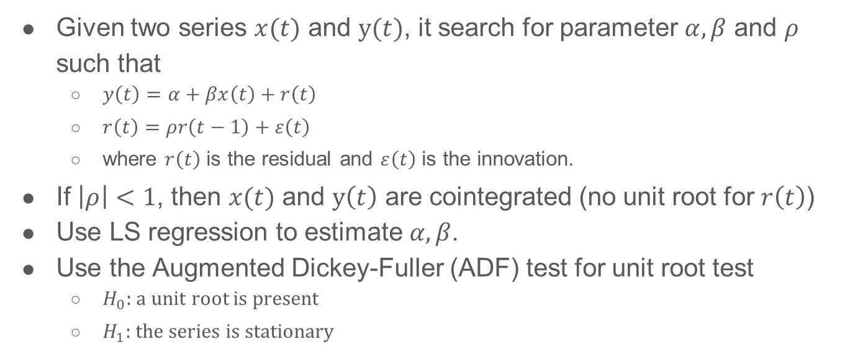
Engle-Granger cointegration test
Given two series $x(t)$ and $y(t)$, it search for parameter $α,β$ and $ρ$ such that
$y\left(t\right)=α+βx\left(t\right)+r\left(t\right)$
$r\left(t\right)=ρr\left(t−1\right)+ε\left(t\right)$
where $r\left(t\right)$ is the residual and $ε\left(t\right)$ is the innovation.
If $\left|ρ\right|<1$, then $x(t)$ and $y\left(t\right)$ are cointegrated (no unit root for $r\left(t\right)$)
Use LS regression to estimate $α,β$.
Use the Augmented Dickey-Fuller (ADF) test for unit root test
$H_{0}:$a unit root is present
$H_{1}:$the series is stationary
Notes:
单整是处理伪回归问题的一种方式。如果一个时间序列经过一次差分变成平稳的，则称原序列是1阶单整的，记为I（1）。 一般地，如果时间序列经过d次差分后变成平稳序列，而经过d-1次差分仍不平稳，则称原序列是d阶单整序列，记为I（d）。
如果一个随机过程{xt}如果必须经过d次差分之后才能变成一个平稳的，可逆的ARMA过程，而当进行d-1次差分后仍是一个非平稳的过程，则称该过程具有d阶单整性。

Slide 6
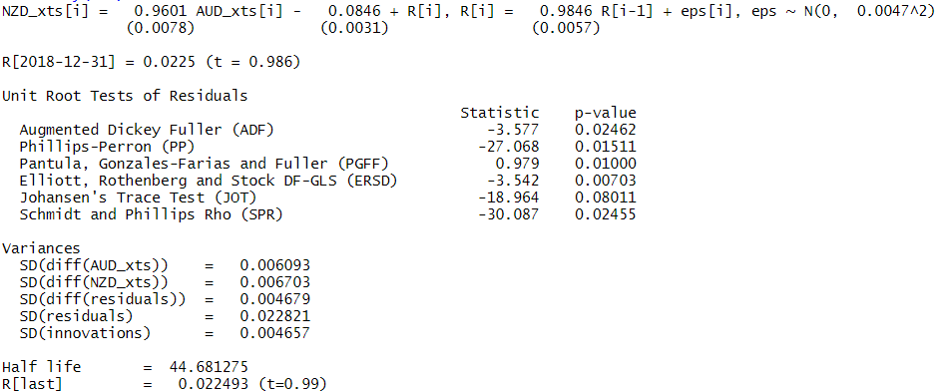
Testing result

Slide 7
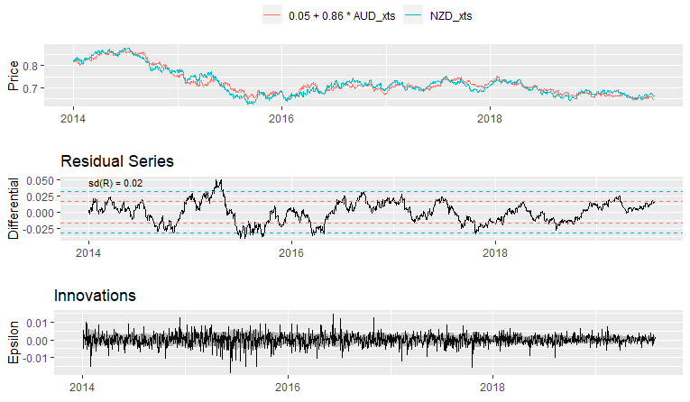
Plot testing result

Slide 8
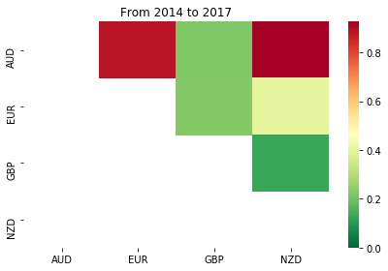
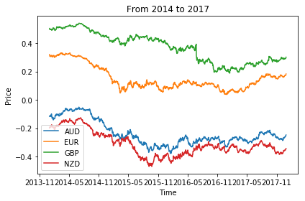
Selected pair and period

Slide 9
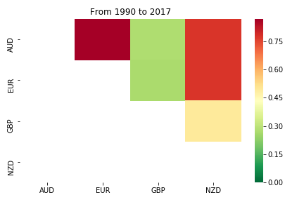
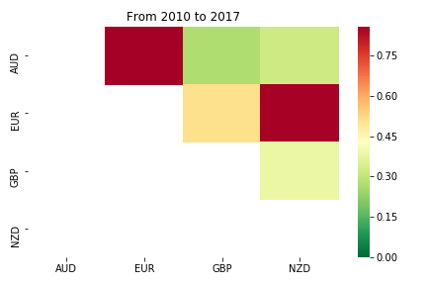
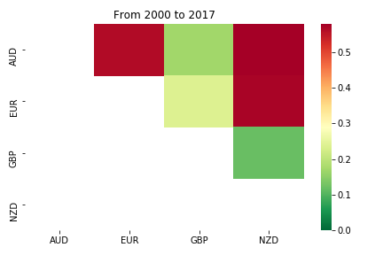
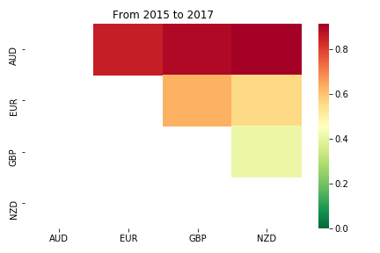
Other tading period

Slide 10
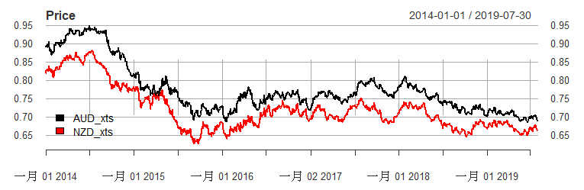
Log prices of AUD and NZD against USD

Slide 11
Trading strategy

Slide 12
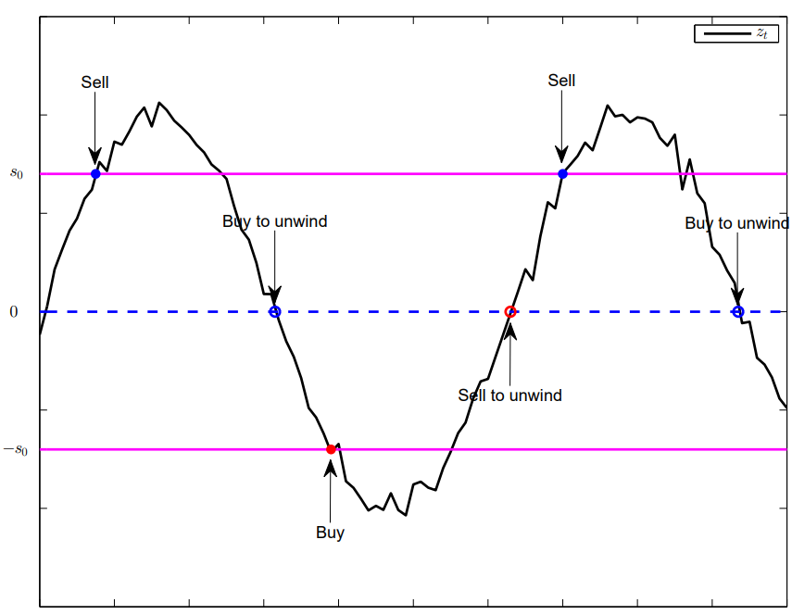

Trading strategy
Suppose the stationary spread $z_{t} = y_{1}(t)−γy_{2}(t)$has mean zero.
Statistical Arbitrage:
If spread is low $(z_{t}<−s_{0})$:
Buy the spread
Unwind the position when it reverts to
zero $i$ time steps $z_{t−1}=0$
If spread is high $(z_{t}>s_{0})$:
short-sell the spread
Unwind the position when it reverts to
zero $i$ time steps $z_{t−1}=0$
​Yiyong Feng and Daniel P. Palomar, A Signal Processing Perspective on Financial Engineering, Foundations and Trends® in Signal Processing, Now Publishers, 2016.

Slide 13
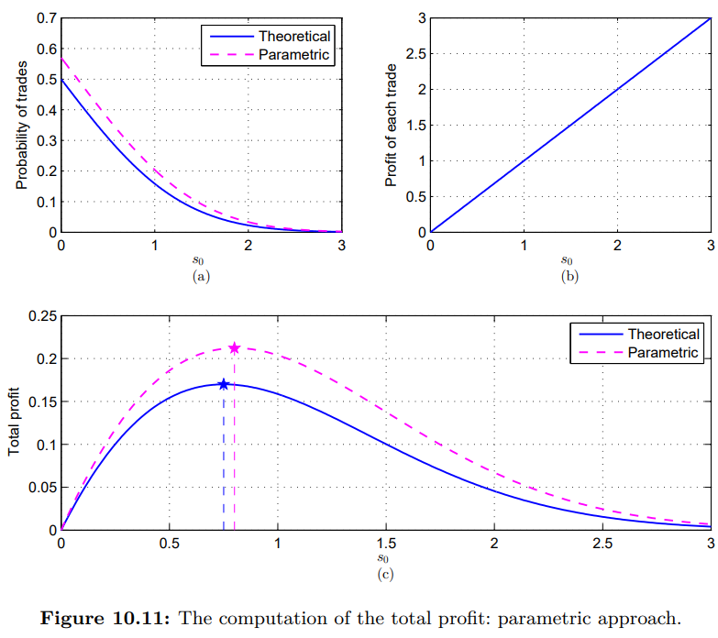

Optimum threshold $s_{0}$: Parametric approach
Fit the spread dynamic with a specific model
white Gaussian noise model
Set threshold $s_{0}$ = 0.75
​Yiyong Feng and Daniel P. Palomar, A Signal Processing Perspective on Financial Engineering, Foundations and Trends® in Signal Processing, Now Publishers, 2016.

Slide 14
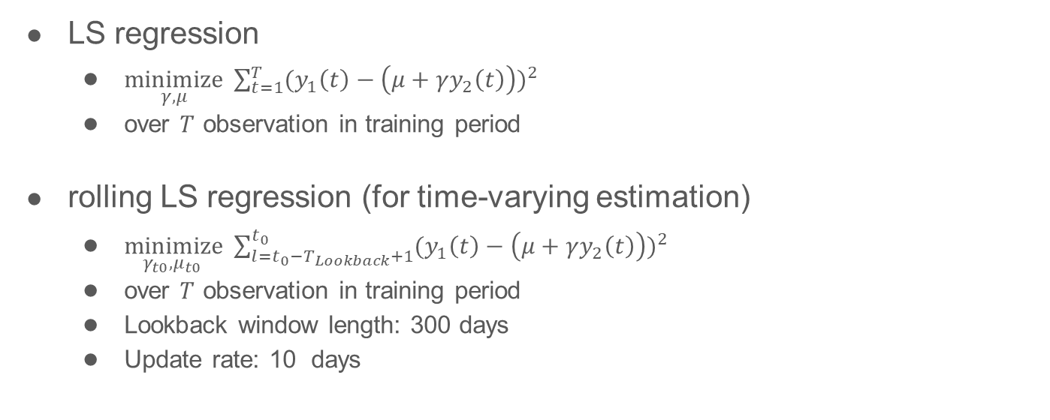
Methodology for estimating γ and μ
LS regression
$\underset{γ,μ}{minimize}{ \sum_{t=1}^{T}{{(y_{1}\left(t\right)−\left(μ+γy_{2}\left(t\right)\right))}^{2}}}$
over $T$ observation in training period
rolling LS regression (for time-varying estimation)
$\underset{γ_{t0},μ_{t0} }{minimize}{ \sum_{l=t_{0}−T_{Lookback}+1}^{t_{0}}{{(y_{1}\left(t\right)−\left(μ+γy_{2}\left(t\right)\right))}^{2}}}$
over $T$ observation in training period
Lookback window length: 300 days
Update rate: 10 days

Slide 15
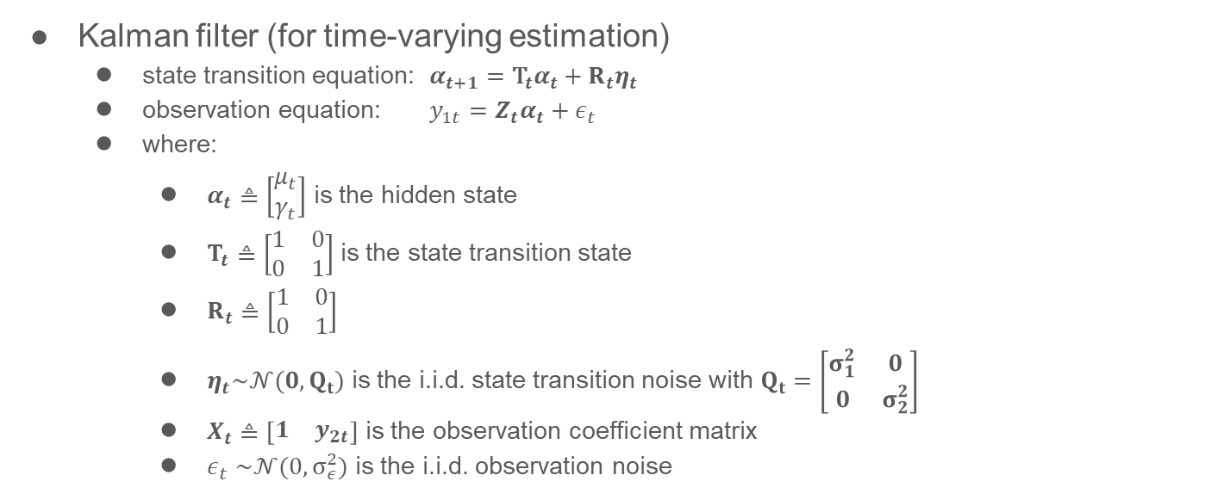
Methodology for estimating γ and μ (cont’d)
Kalman filter (for time-varying estimation)
state transition equation: $α_{t+1}={\text{T}}_{t}α_{t}+R_{t}η_{t}$
observation equation: $y_{1t}=Z_{t}α_{t}+ε_{t}$
where:
$α_{t}≜\left[\begin{matrix}μ_{t} \\ γ_{t}\end{matrix}\right]$ is the hidden state
$T_{t}≜\left[\begin{matrix}1 & 0 \\ 0 & 1\end{matrix}\right]$ is the state transition state
$R_{t}≜\left[\begin{matrix}1 & 0 \\ 0 & 1\end{matrix}\right]$
$η_{t}\sim 𝒩(0, Q_{t})$ is the i.i.d. state transition noise with $Q_{t}=\left[\begin{matrix}σ_{1}^{2} & 0 \\ 0 & σ_{2}^{2}\end{matrix}\right]$
$X_{t}≜\left[\begin{matrix}1 & y_{2t}\end{matrix}\right]$ is the observation coefficient matrix
$ε_{t}$ $\sim 𝒩(0,σ_{ε}^{2})$ is the i.i.d. observation noise

Slide 16
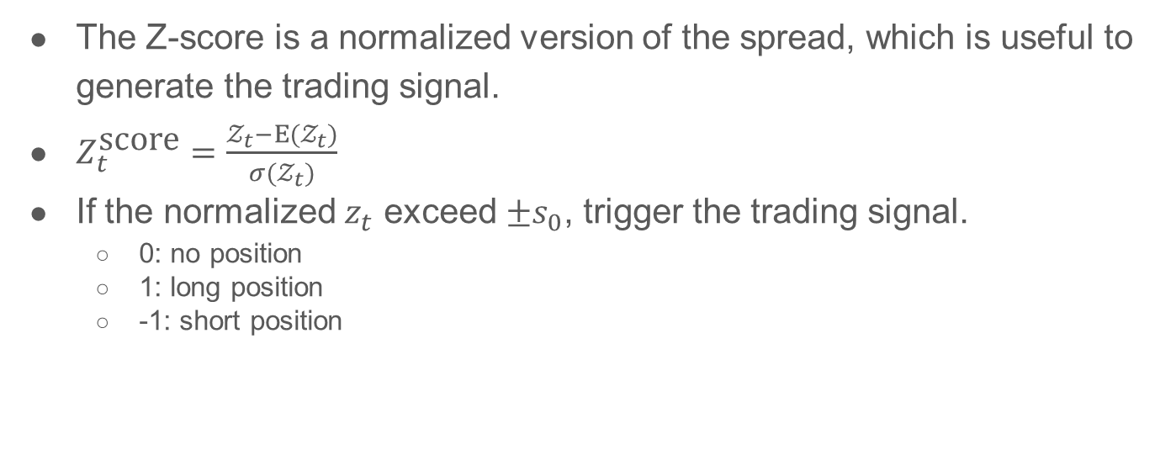
Z-normalization and Signal generating
The Z-score is a normalized version of the spread, which is useful to generate the trading signal.
$Z_{t}^{\text{score}}=\frac{𝒵_{t}−E(𝒵_{t})}{σ(𝒵_{t})}$
If the normalized $z_{t}$ exceed $±s_{0}$, trigger the trading signal.
0: no position
1: long position
-1: short position

Slide 17
Experiment results

Slide 18
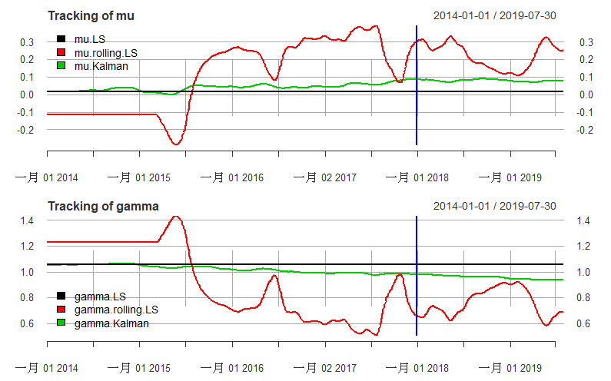
Parameter tracking

Slide 19
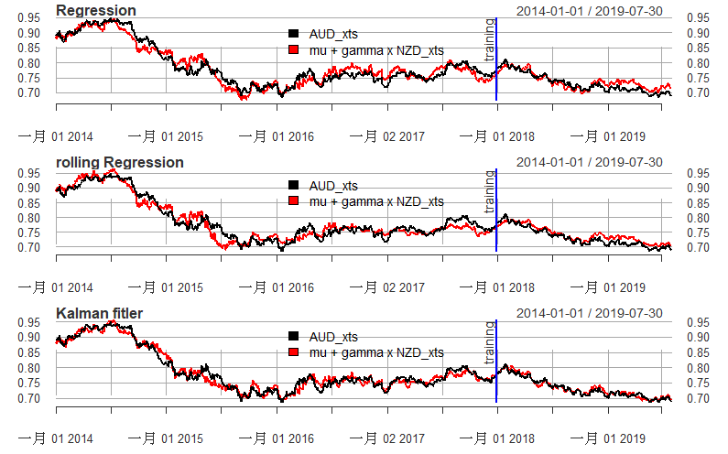
Regression using different estimation method

Slide 20
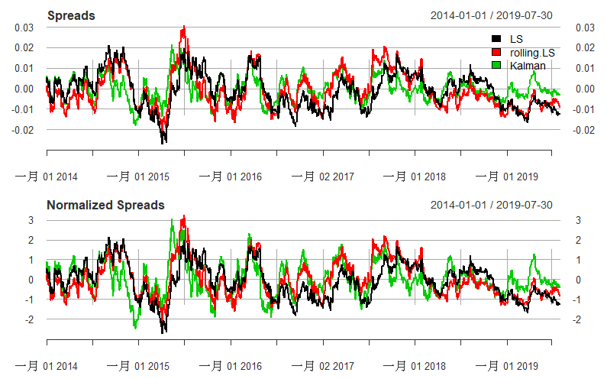
Spread

Slide 21
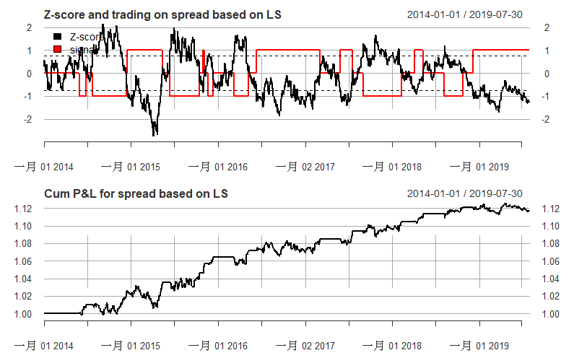
LS regression

Slide 22
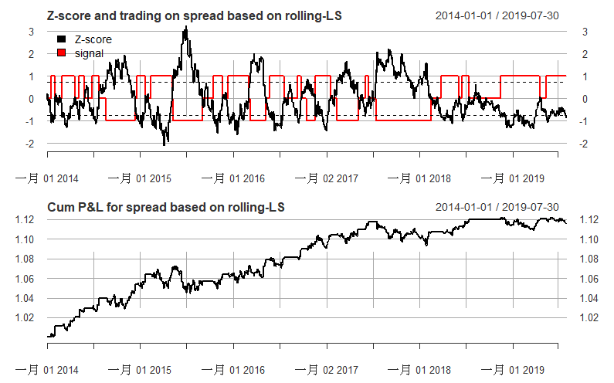
Rolling LS regression

Slide 23
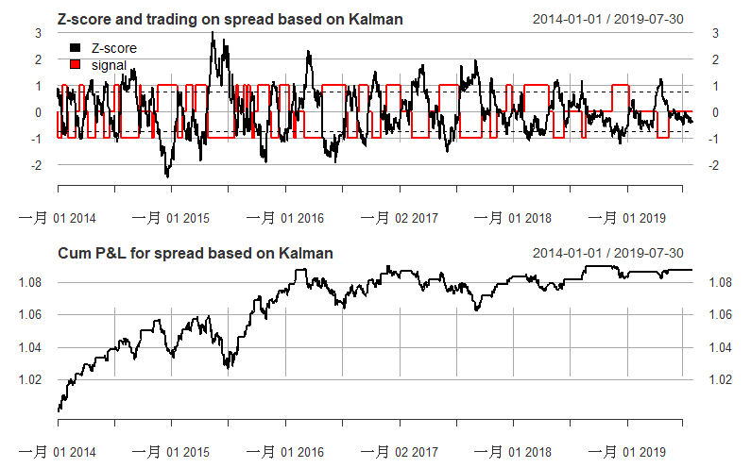
Kalman filter

Slide 24
Performance measurement (on testing period)
 | LS | rolling-LS | Kalman
Volatility | 0.000961 | 0.000982 | 0.000704
StdDev Sharpe (Rf=0%, p=95%) | 0.05048 | 0.032425 | 0.014489
VaR Sharpe (Rf=0%, p=95%) | 0.034155 | 0.022289 | 0.009267
ES Sharpe (Rf=0%, p=95%) | 0.02301 | 0.016852 | 0.005584
Holding period | 46.5 | 33.75 | 15.4
Cumulative return | 0.019793 | 0.012944 | 0.004204

Slide 25
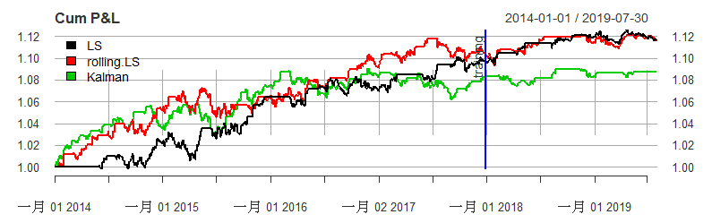
Cumulative P&L Curve
Compute the cumulative P&L.
The same initial budget of, say, 1$ is reinvested every time we enter a trade (even if the wealth at some point is 10$, still only 1$ is invested).

Slide 26
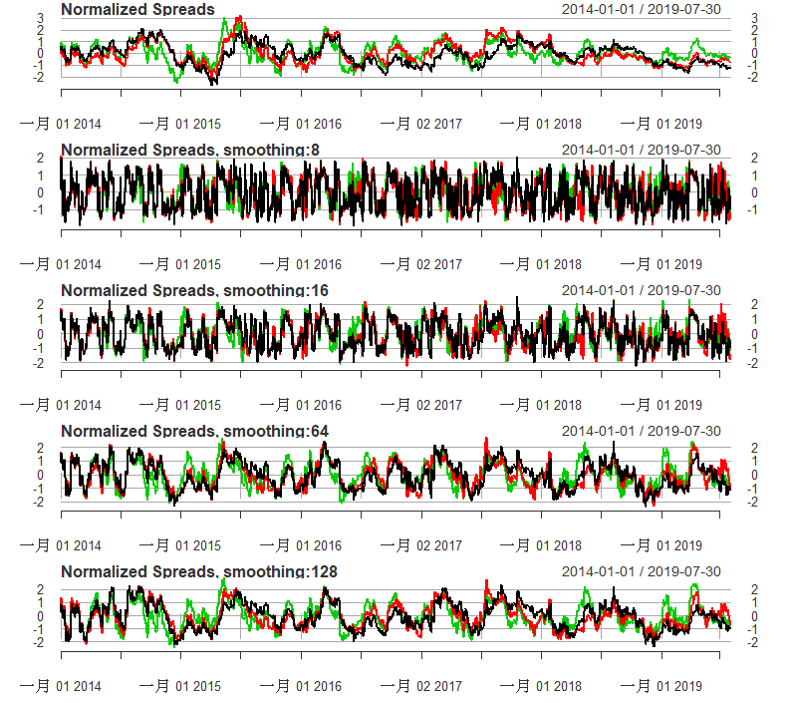
Different exponential smoothing window for spread
Here we can smooth the mean and variance for normalization to control the trading frequency.
The parameters are then time-varying.
Spread normalized by various smoothing window is visualized.

Slide 27
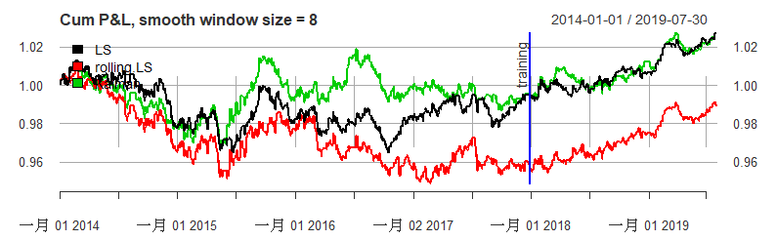
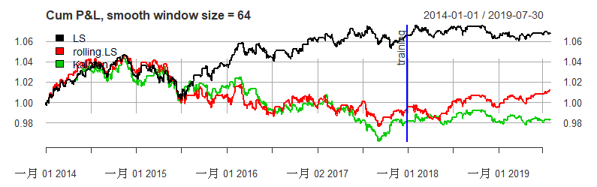
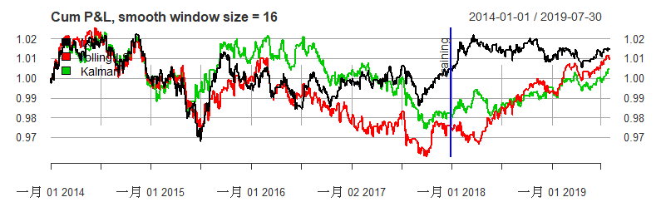
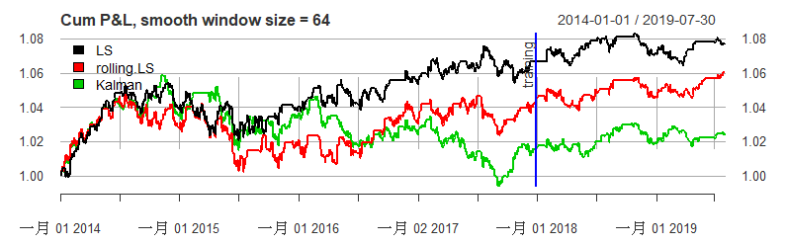
Cumulative P&L using various spread smoothing window

Slide 28
Conclusion

Slide 29
Conclusion
In our considered time period (2014-2019), the parameters do not change abruptly so that LS generates comparable results.
Cointegration can be detected in the given dataset, but its persistence is not clear and hard to find a proper period.
Parameters for normalized spread construction is sensitive to the trading performance.

